Slide 1
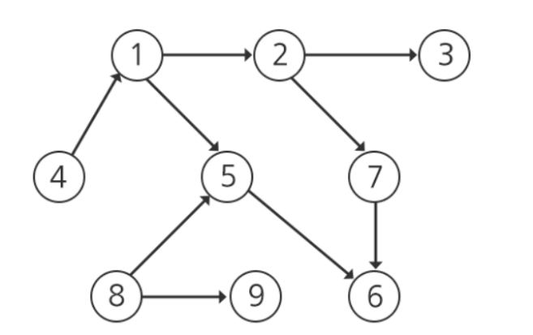
The order of work
 | 0 | 1 | 2 | 3 | 4 | 5 | 6 | 7 | 8 | 9
0
1 |  |  | 1 |  |  | 1
2 |  |  |  | 1 |  |  |  | 1
3
4 |  | 1
5 |  |  |  |  |  |  | 1
6
7 |  |  |  |  |  |  | 1
8 |  |  |  |  |  | 1 |  |  |  | 1
9
1 2
2 3
1 2
2 3
4 1
1 5
2 7
7 6
5 6
8 5
9 8
4 1
1 5
2 7
7 6
5 6
8 5
8 9
InDegree
0 | 1 | 2 | 3 | 4 | 5 | 6 | 7 | 8 | 9
2
2
1
1
1
1
1
1
1
OutDegree
0 | 1 | 2 | 3 | 4 | 5 | 6 | 7 | 8 | 9
2
1
1
1
1
1
1
2
2

Slide 2
The order of work
 | 0 | 1 | 2 | 3 | 4 | 5 | 6 | 7 | 8 | 9
0
1 |  |  | 1 |  |  | 1
2 |  |  |  | 1 |  |  |  | 1
3
4 |  | 1
5 |  |  |  |  |  |  | 1
6
7 |  |  |  |  |  |  | 1
8 |  |  |  |  |  | 1 |  |  |  | 1
9
1 2
2 3
4 1
1 5
2 7
7 6
5 6
8 5
8 9
InDegree
0 | 1 | 2 | 3 | 4 | 5 | 6 | 7 | 8 | 9
-1 | 1 | 1 | 1 | 0 | 2 | 2 | 1 | 0 | 1
-1
0
0
0
1
0
-1
-1
4
1
2

